Slide 1
Regression with Regularization I
Statistical Data Analysis, 2023

Slide 2
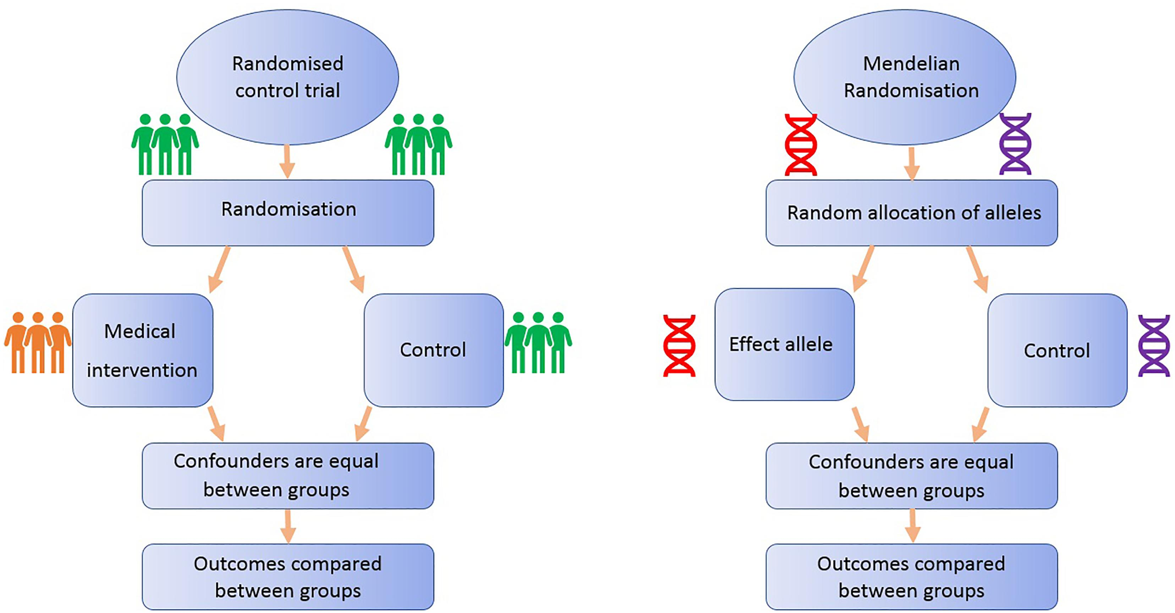
Methods for casual relations in epidemiology
C
X
Y
One difficulty of identifying casual relations in observational studies:
Confounders are not controlled.
Randomized control trials (RCT) are too expansive...
Also useful in observational studies !!

Slide 3
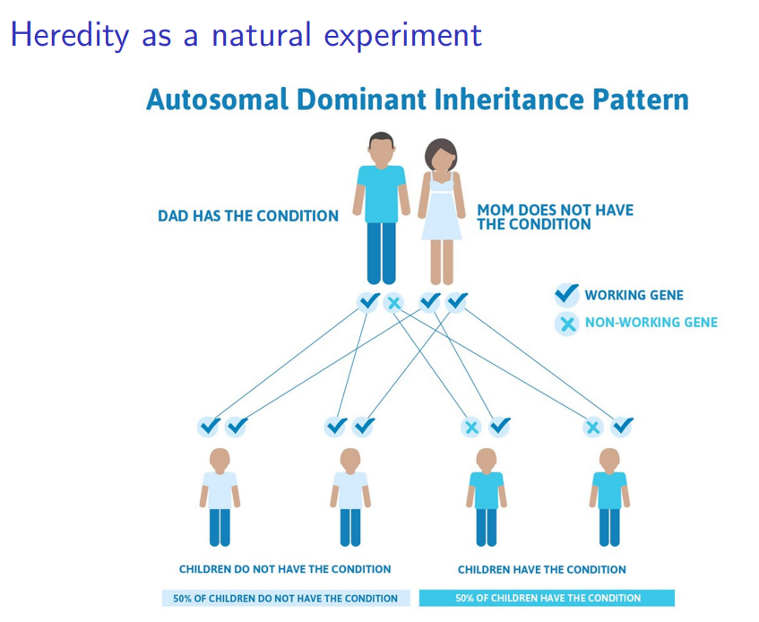
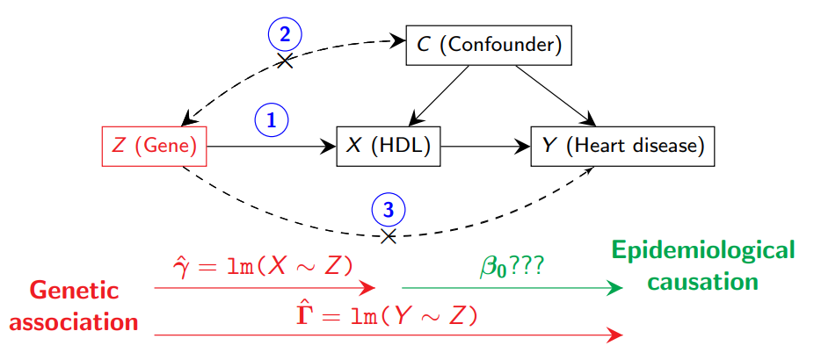
The availability of GWAS datasets makes Mendelian Randomization a very popular tool to infer causality in epidemiology and human genetics.
Nature has done a randomized experiment for us!

Slide 4
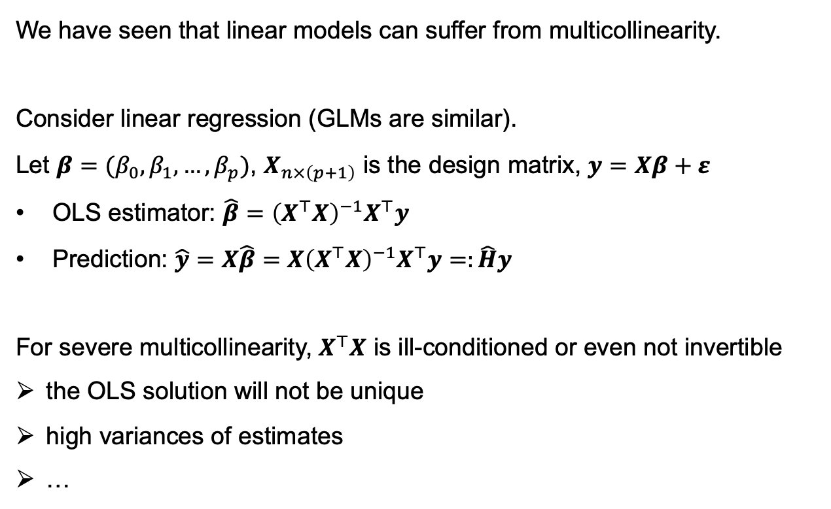
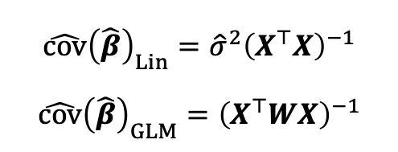
Motivation 1 — Multicollinearity
We have seen that linear models can suffer from multicollinearity.
Consider linear regression (GLMs are similar).
Let $β=(β_{0},β_{1},…,β_{p})$, $X_{n×\left(p+1\right)}$ is the design matrix, $y=Xβ+ε$
OLS estimator: $\hat{β}={\left(X^{⊤}X\right)}^{−1}X^{⊤}y$
Prediction: $\hat{y}=X\hat{β}=X{\left(X^{⊤}X\right)}^{−1}X^{⊤}y=:\hat{H}y$
For severe multicollinearity, $X^{⊤}X$ is ill-conditioned or even not invertible
the OLS solution will not be unique
high variances of estimates
…
$$\hat{cov}{\left(\hat{β}\right)}_{Lin}={\hat{σ}}^{2}{\left(X^{⊤}X\right)}^{−1}$$
$$\hat{cov}{\left(\hat{β}\right)}_{GLM}={\left(X^{⊤}WX\right)}^{−1}$$

Slide 5
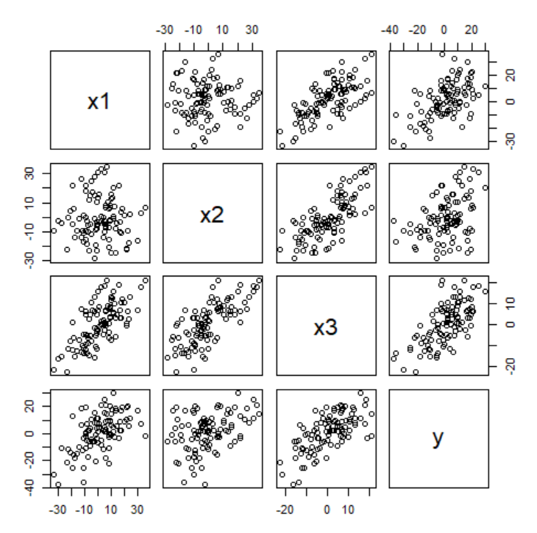
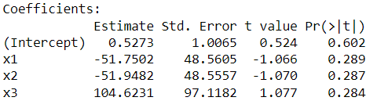
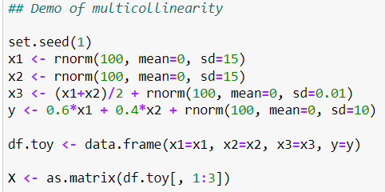
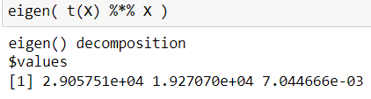
Motivation 1 — Multicollinearity

Slide 6
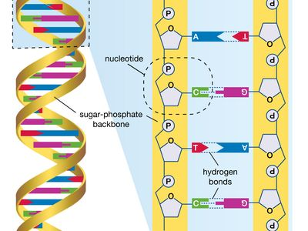
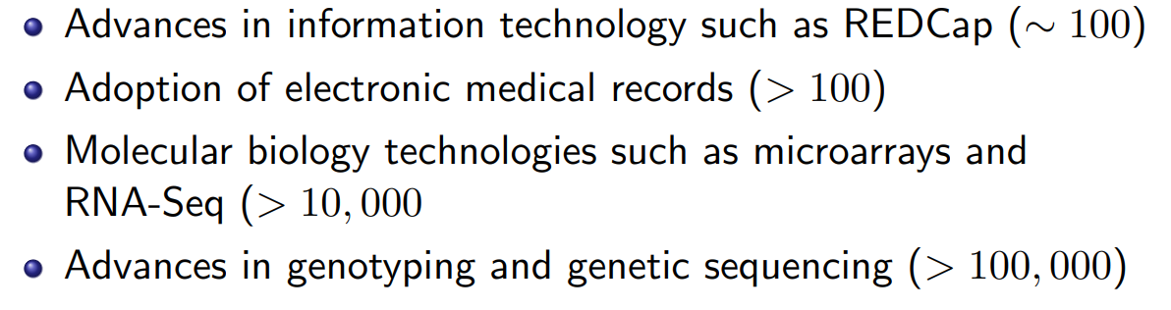
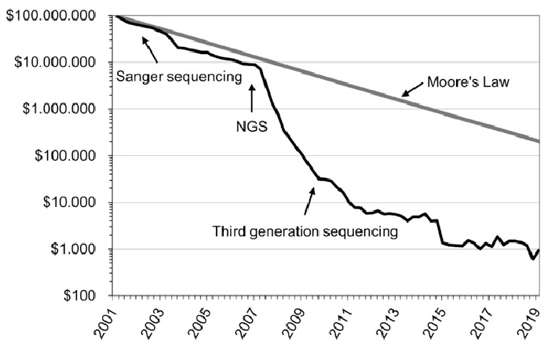
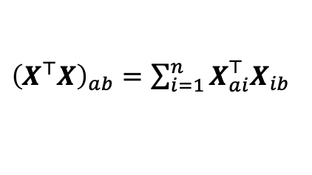
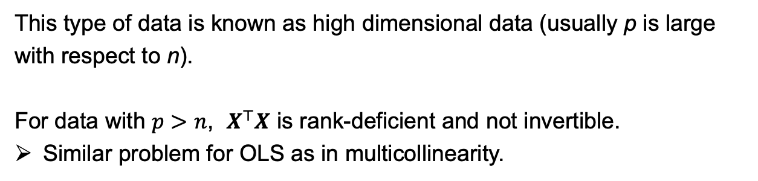
Motivation 2 — High dimensional data
In the past 20 years, new technologies have changed the way that data are collected. It is now common to collect a large number of feature measurements ( p very large ).
This type of data is known as high dimensional data (usually p is large with respect to n).
For data with $p>n$, $X^{⊤}X$ is rank-deficient and not invertible.
Similar problem for OLS as in multicollinearity.
${\left(X^{⊤}X\right)}_{ab}=\sum_{i=1}^{n}{X_{ai}^{⊤}X_{ib}}$
Notes:
Other high D data: online shopping patterns, network data, etc.
XTX: (p+1)x(p+1) matrix, but only n independent components.

Slide 7
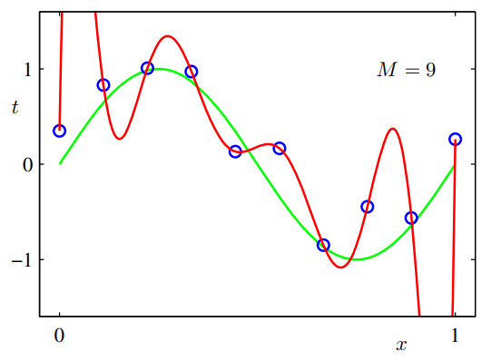
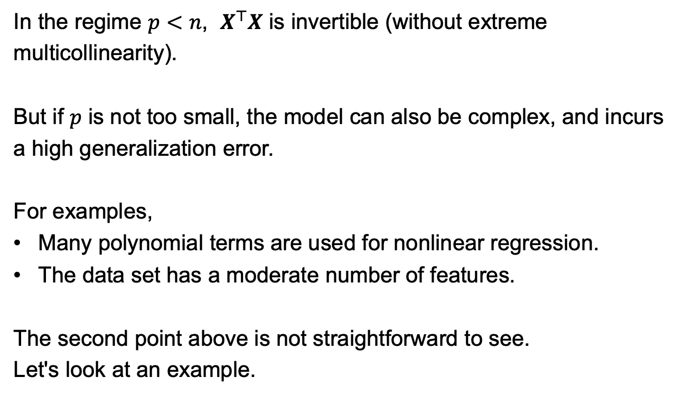
Motivation 3 — Reducing test error
In the regime $p<n$, $X^{⊤}X$ is invertible (without extreme multicollinearity).
But if $p$ is not too small, the model can also be complex, and incurs a high generalization error.
For examples,
Many polynomial terms are used for nonlinear regression.
The data set has a moderate number of features.
The second point above is not straightforward to see.
Let's look at an example.

Slide 8
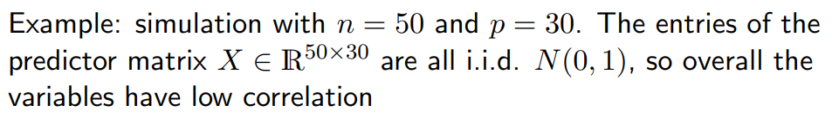
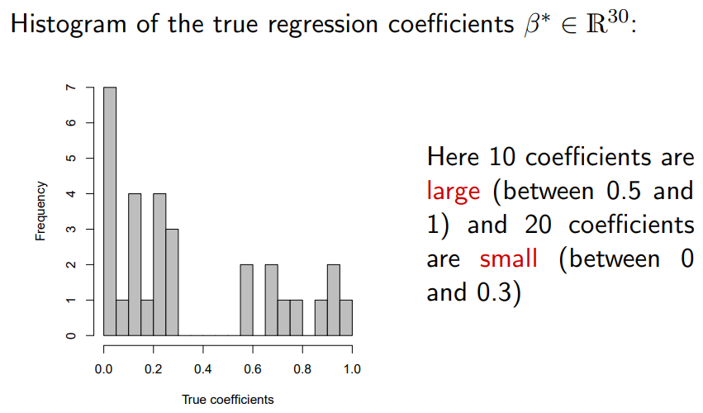
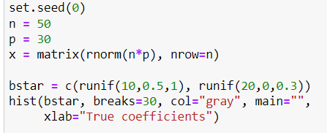
Motivation 3 — Example A
[R. Tibshirani]

Slide 9

投票
最多可选1项
The ground truth function has 30 unknown non-zero coefficients. Suppose we only have 50 observations, do you think it a good idea to fit to all 30 variables using ordinary linear regression?
A
Yes
B
No
提交
Notes:
Some points to consider:
(1) All coefficients are non-zero, so dropping any of them is biased.
(2) But n is small w.r.t. p.

Slide 10
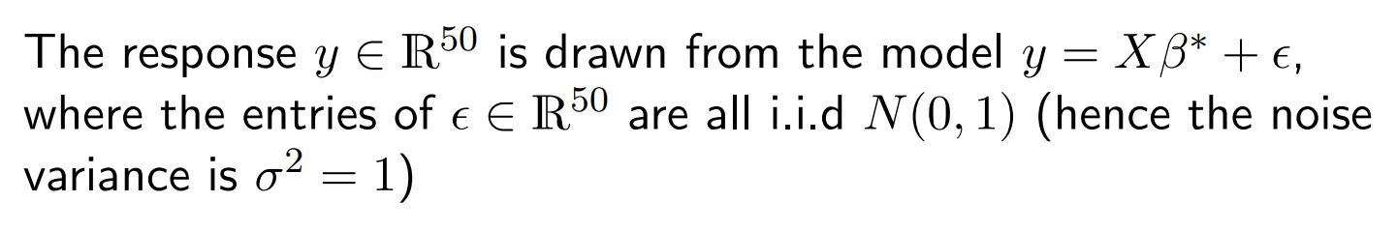
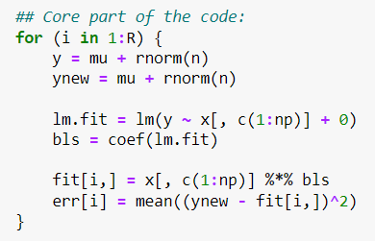
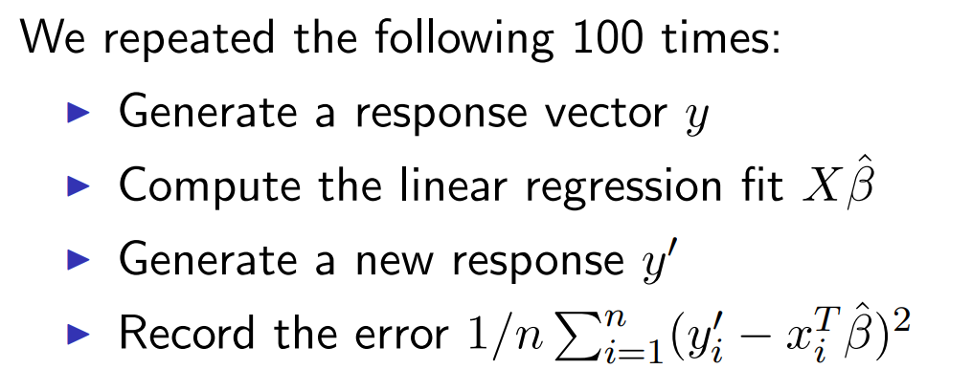
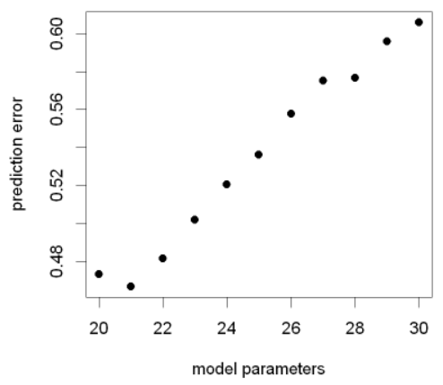
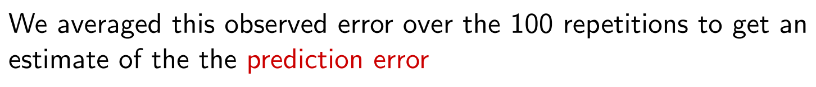
Motivation 3 — Example A
We then drop some small coefficients from the models and repeat the above process.
Fitting to all regressors using OLS is sub-optimal.
Notes:
In terms of reducing prediction error, simpler models are favored, even though the ground truth includes all the coefficients…

Slide 11
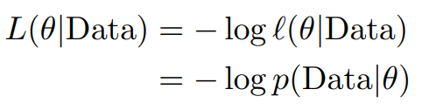
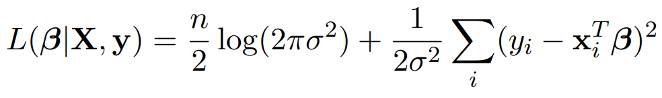
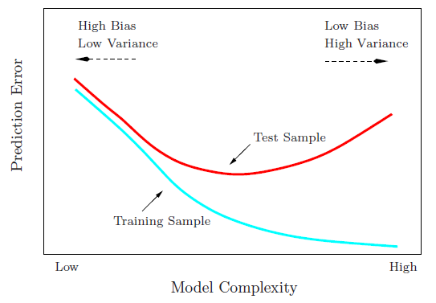
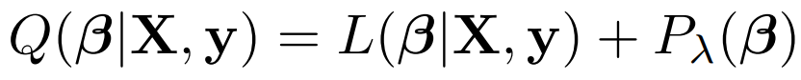
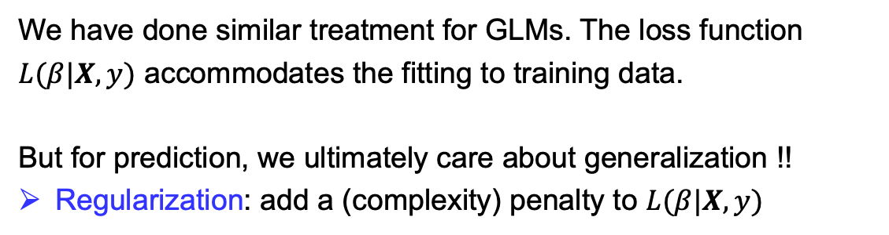
Regularized Regression
To obtain a model that fits the (training) data well, we primarily used the maximum likelihood estimations, e.g., by minimizing the negative log-likelihood
For linear regression
Least square loss
We have done similar treatment for GLMs. The loss function $L(β|X, y)$ accommodates the fitting to training data.
But for prediction, we ultimately care about generalization !!
Regularization: add a (complexity) penalty to $L(β|X, y)$
Notes:
This is different from AIC, BIC, which estimate the penalty of complexity after fitting.

Slide 12
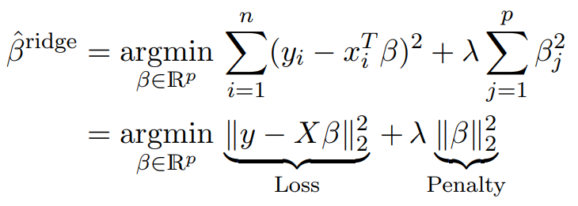
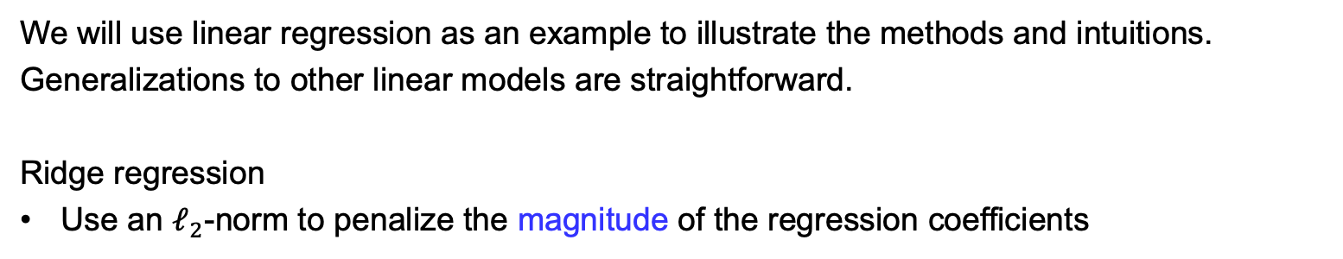
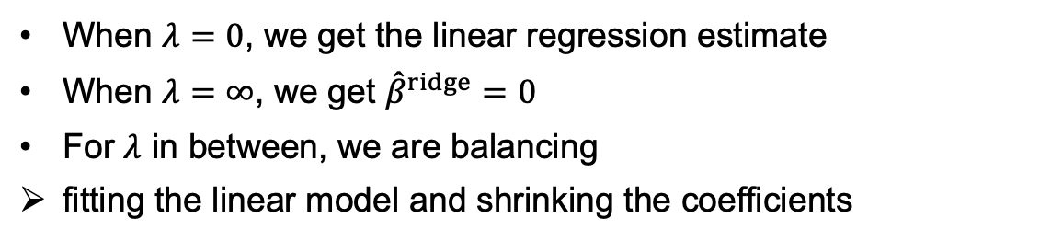
Ridge Regression
We will use linear regression as an example to illustrate the methods and intuitions.
Generalizations to other linear models are straightforward.
Ridge regression
Use an $ℓ_{2}$-norm to penalize the magnitude of the regression coefficients
(suppose there is no intercept term)
When $λ=0$, we get the linear regression estimate
When $λ=∞$, we get ${\hat{β}}^{ridge}=0$
For $λ$ in between, we are balancing
fitting the linear model and shrinking the coefficients

Slide 13
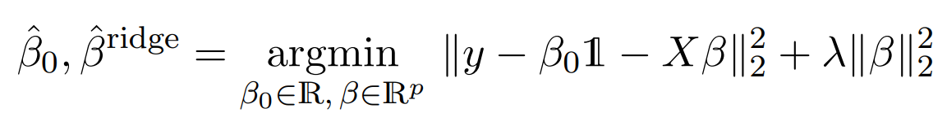
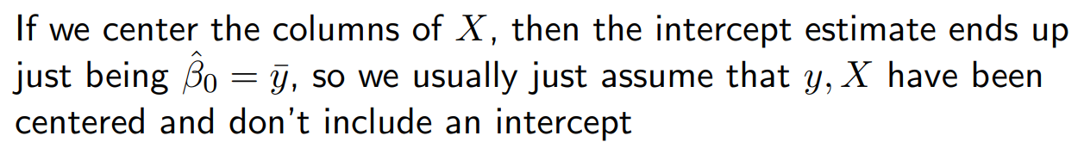
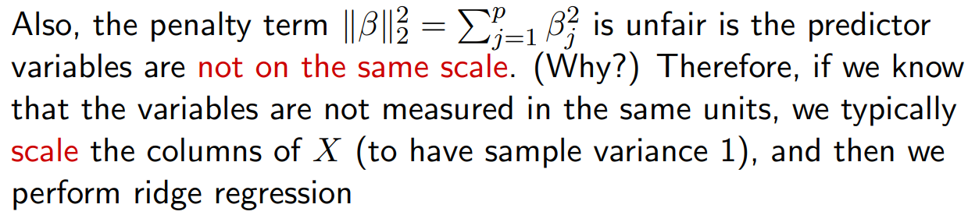
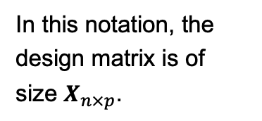
Ridge Regression — A detail
When including an intercept term in the regression, we usually leave this coefficient unpenalized, and solve
In this notation, the design matrix is of size $X_{n×p}$.
Many packages provide an option to do it automatically.

Slide 14
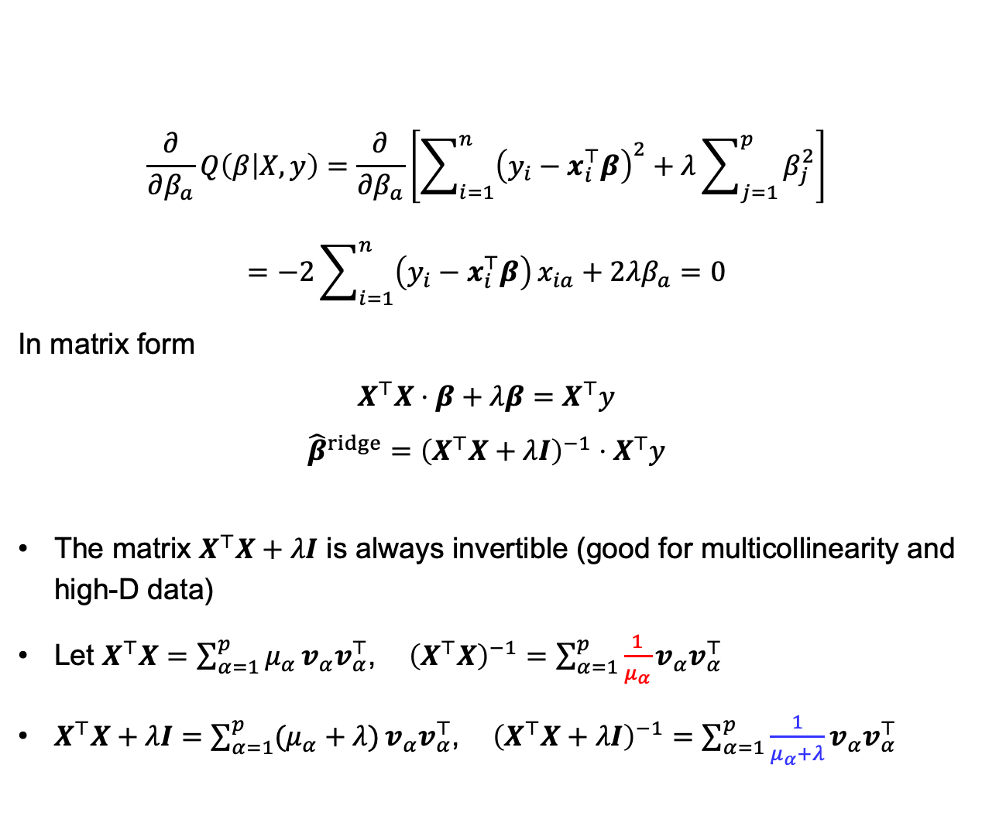
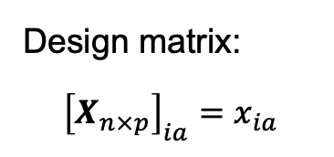
Ridge Regression — Solution
$$\frac{∂}{∂β_{a}}Q\left(β | X,y\right)=\frac{∂}{∂β_{a}}\left[\sum_{i=1}^{n}{{\left(y_{i}−x_{i}^{⊤}β\right)}^{2}}+λ\sum_{j=1}^{p}{β_{j}^{2}}\right]$$
$$=−2\sum_{i=1}^{n}{\left(y_{i}−x_{i}^{⊤}β\right)}x_{ia}+2λβ_{a}=0$$
In matrix form
$$X^{⊤}X⋅β+λβ=X^{⊤}y$$
$${\hat{β}}^{ridge}={\left(X^{⊤}X+λI\right)}^{−1}⋅X^{⊤}y$$
The matrix $X^{⊤}X+λI$ is always invertible (good for multicollinearity and high-D data)
Let $X^{⊤}X=\sum_{α=1}^{p}{μ_{α}}v_{α}v_{α}^{⊤}$, ${\left(X^{⊤}X\right)}^{−1}=\sum_{α=1}^{p}{\frac{1}{μ_{α}}}v_{α}v_{α}^{⊤}$
$X^{⊤}X+λI=\sum_{α=1}^{p}{(μ_{α}+λ)}v_{α}v_{α}^{⊤}$, ${\left(X^{⊤}X+λI\right)}^{−1}=\sum_{α=1}^{p}{\frac{1}{μ_{α}+λ}}v_{α}v_{α}^{⊤}$
Design matrix:
$${\left[X_{n×p}\right]}_{ia}=x_{ia}$$
Shrinkage of the OLS estimations.

Slide 15
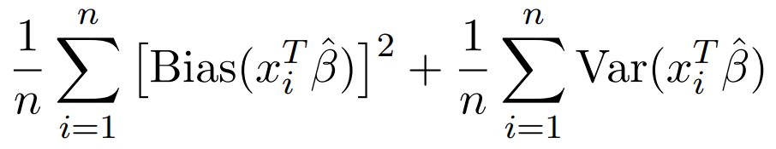
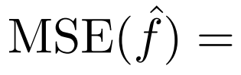
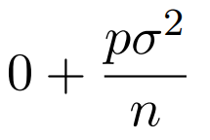
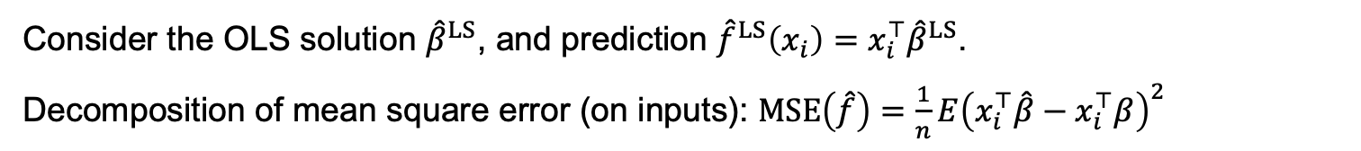
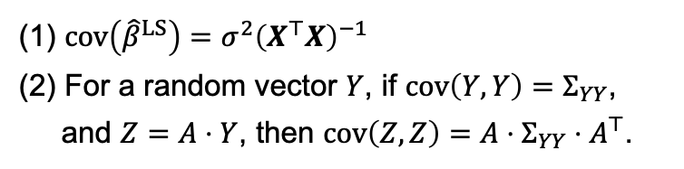
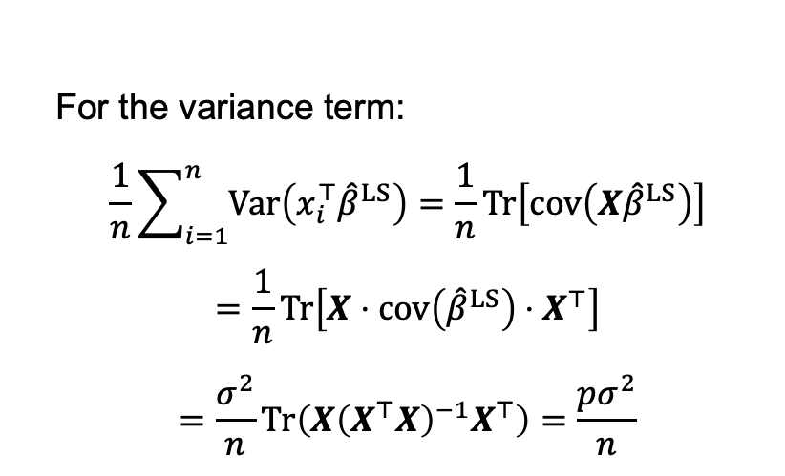
Why Shrinkage ?
Consider the OLS solution ${\hat{β}}^{LS}$, and prediction ${\hat{f}}^{LS}\left(x_{i}\right)=x_{i}^{⊤}{\hat{β}}^{LS}$.
Decomposition of mean square error (on inputs): $MSE\left(\hat{f}\right)=\frac{1}{n}E{\left(x_{i}^{⊤}\hat{β}−x_{i}^{⊤}β\right)}^{2}$
OLS estimation is the MLE estimation, therefore unbiased.
For the variance term:
$$\frac{1}{n}\sum_{i=1}^{n}{Var\left(x_{i}^{⊤}{\hat{β}}^{LS}\right)}=\frac{1}{n}Tr\left[cov\left(X{\hat{β}}^{LS}\right)\right]$$
$$=\frac{1}{n}Tr\left[X⋅cov\left({\hat{β}}^{LS}\right)⋅X^{⊤}\right]$$
$$=\frac{σ^{2}}{n}Tr\left(X{\left(X^{⊤}X\right)}^{−1}X^{⊤}\right)=\frac{pσ^{2}}{n}$$
(1) $cov\left({\hat{β}}^{LS}\right)=σ^{2}{\left(X^{⊤}X\right)}^{−1}$
(2) For a random vector $Y$, if $cov\left(Y,Y\right)=Σ_{YY}$,
and $Z=A⋅Y$, then $cov\left(Z,Z\right)=A⋅Σ_{YY}⋅A^{⊤}$.
This scales linearly with the number of predictors.
Notes:
Similar to bias-variance decomposition of parameters.

Slide 16
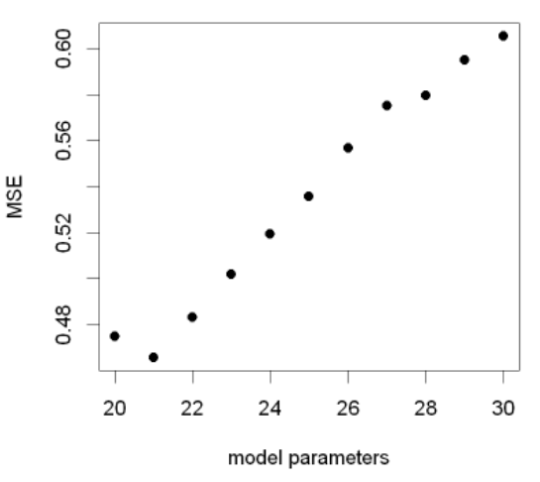
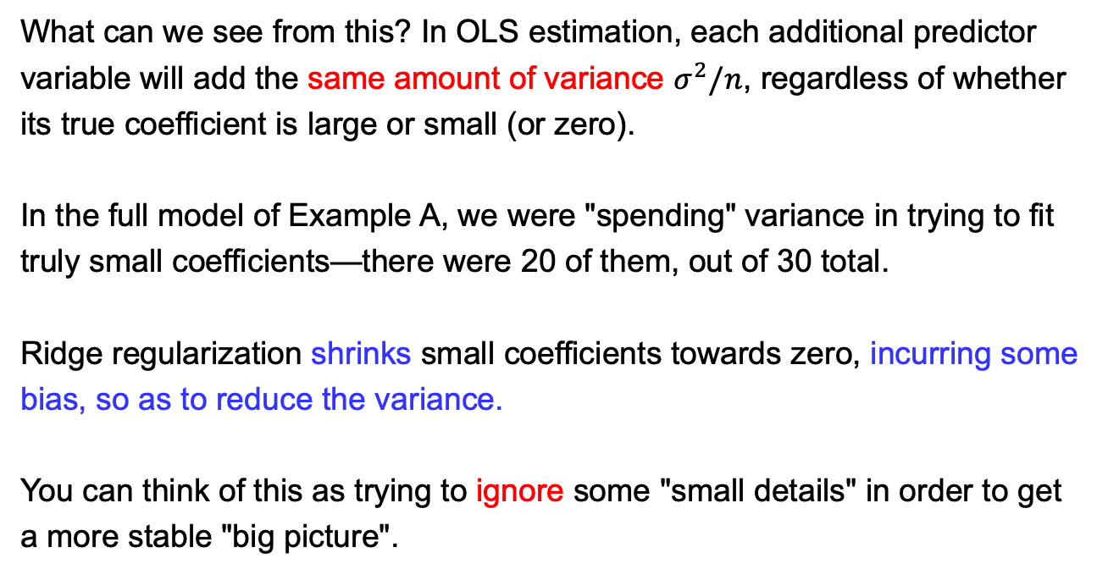
Why Shrinkage ?
What can we see from this? In OLS estimation, each additional predictor variable will add the same amount of variance $σ^{2}/n$, regardless of whether its true coefficient is large or small (or zero).
In the full model of Example A, we were "spending" variance in trying to fit truly small coefficients—there were 20 of them, out of 30 total.
Ridge regularization shrinks small coefficients towards zero, incurring some bias, so as to reduce the variance.
You can think of this as trying to ignore some "small details" in order to get a more stable "big picture".
Notes:
Simplest case: beta’ = a * beta,
if a < 1, then var(beta’) < var(beta).

Slide 17
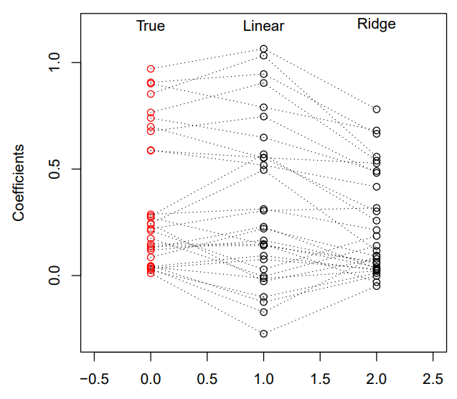
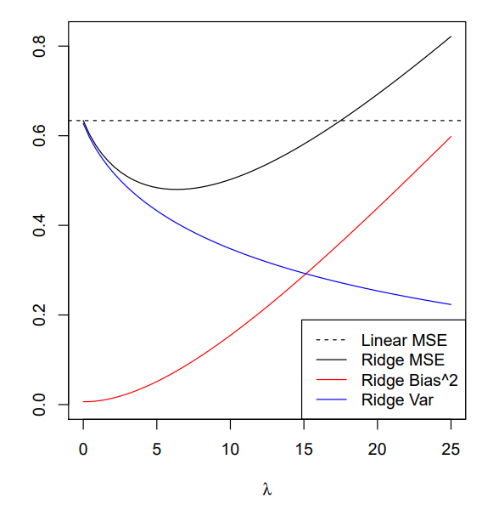
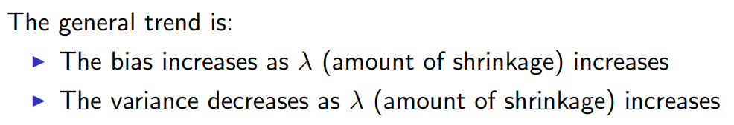
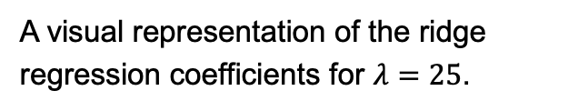
Ridge Regression — Example A
A visual representation of the ridge regression coefficients for $λ=25$.

Slide 18

What you may (should) be thinking now
Thought 1:
“Yeah, OK, but this only works for some values of $λ$. So how would we choose $λ$ in practice?”
Thought 2:
“What happens when none of the coefficients are small?”
In other words, if all the true coefficients are moderately large, is it still helpful to shrink the coefficient estimates?
The answer is (perhaps surprisingly) still "yes".
But the advantage of ridge regression here is less dramatic.

Slide 19




Ridge Regression — Example B
Same setup as Example A: $n=50, p=30$, and $σ^{2}=1$. Except now the true coefficients are all moderately large (between 0.5 and 1).
Ridge regression can still outperform linear regression in terms of mean squared error.
The range for good values of $λ$ is smaller.

Slide 20
Ridge Regression — Zero coefficients
To the other extreme, suppose that there is a group of true coefficients that are identically zero. This means that the mean response doesn't depend on these predictors at all.
This involves a variable selection problem. Aside from predictive accuracy, this can be very important for the purposes of model interpretation.
Thought 3:
"How does ridge regression perform if a group of the true coefficients was exactly zero?"
The answer depends whether on we are interested in prediction or interpretation. We'll consider the former first.

Slide 21



Ridge Regression — Example C
Same setup as Example A and B: $n=50, p=30$, and $σ^{2}=1$. Now, the true coefficients: 10 are large (between 0.5 and 1) and 20 are exactly 0.
Ridge regression still performs well in terms of mean squared error.

Slide 22



Ridge Regression — Example C
Remember that as we vary $λ$ we get different ridge regression coefficients, the larger the $λ$ the more shrunken.
Red paths: the true nonzero coefficients
Gray paths: the true zeros coefficients.
The vertical dashed line at $λ=15$: the point above which ridge regression's MSE starts losing to that of linear regression.
Important to notice: the gray coefficient paths are not exactly zero; they are shrunken, but still nonzero.

Slide 23



Ridge Regression doesn’t perform variable selection
Ridge regression doesn't set coefficients exactly to zero unless $λ=∞$.
Hence ridge regression cannot perform variable selection.
Even though it performs well in terms of prediction accuracy, it does poorly in terms of offering a clear interpretation.

Slide 24

Ridge Regression — Example of PSA
Notes:
Usually in a linear-regression fit with p variables, the degrees-of-freedom of the fit is p, the number of free parameters.
Although all p coefficients in a ridge fit will be non-zero, they are fitted in a restricted fashion controlled by λ.
Observe the switching signs of some coefficients.

Slide 25

Ridge Regression — Recap
Ridge regression minimizes the usual regression criterion (MLE) plus a penalty term on the squared $ℓ_{2}$-norm of the coefficient vector.
It shrinks the coefficients towards zero. This introduces some bias, but can greatly reduce the variance, resulting in a better mean-squared error.
Ridge regression performs particularly well when there is a subset of true coefficients that are small or even zero.
It doesn't do as well when all of the true coefficients are moderately large (but it can still outperform linear regression by shrinkage).
Ridge regression cannot perform variable selection.

Slide 26


Something Extra
You may still find it a bit surprising that shrinkage helps in Example B.
Here is an even more surprising example:
Consider you have $N$ observations $[x_{1},x_{2},…,x_{N}]$
It is known that each observation $x_{i} \sim N(μ_{i},1)$ (The means $μ_{i}$ are different)
How to obtain a good estimate of $μ={\left[μ_{1},μ_{2},…,μ_{N}\right]}^{⊤}$ from $x={\left[x_{1},x_{2},…,x_{N}\right]}^{⊤}$ ?
Estimation for each individual player.

Slide 27



Something Extra
Problem: $N$ observations $[x_{1},x_{2},…,x_{N}]$, $x_{i}|μ_{i} \sim N(μ_{i},1)$.
Target: estimate $μ={\left[μ_{1},μ_{2},…,μ_{N}\right]}^{⊤}$ from $x={\left[x_{1},x_{2},…,x_{N}\right]}^{⊤}$
Simplest approach: ${\hat{μ}}_{i}=x_{i}$
In fact, this is the MLE: ${\hat{μ}}^{(MLE)}=x$
Performance measure of an estimator is the usual expected (mean) squared error: $E\left({\left|\left|\hat{μ}−μ\right|\right|}^{2}\right)$.
Surprisingly there is an estimator that outperforms ${\hat{μ}}^{MLE}$ in terms of squared error !!
James-Stein (JS) Estimation: ${\hat{μ}}^{(JS)}=\left(1−\frac{N−2}{{||x||}^{2}}\right)x$
It shrinks the MLE towards zero.
Ronald Fisher,
1890 - 1962
Charles M. Stein,
1920 - 2016

Slide 28






James-Stein Estimation
N=10
N=100
$${\hat{μ}}^{(JS)}=\left(1−\frac{N−2}{{||x||}^{2}}\right)x$$
James-Stein Theorem, 1961
For $N≥3$, the James-Stein estimator everywhere dominates the MLE ${\hat{μ}}^{(MLE)}$ in terms of expected total squred error:
— James and Stein (1961), "Estimation with quadratic loss"
Notes:
The James–Stein theorem came as a rude shock to the statistical world of 1961.
The defeat came on MLE’s home field: normal observations with squared error loss.

Slide 29



James-Stein Estimation
Bradley Efron (1938 - )
(Best known for bootstrap)
$$SE_{MLE}=\sum_{i}{{\left({\hat{μ}}^{MLE}−μ_{i}\right)}^{2}}$$
$$=0.076$$
$$SE_{MLE}=\sum_{i}{{\left({\hat{μ}}^{MLE}−μ_{i}\right)}^{2}}$$
$$=0.021$$
In a paper "Stein's paradox in statistics" (1977), Efron proposed an example:
Target: estimate/predict the batting averages of 18 MLB players in the1970 season, by their first 45 hits.

Slide 30


James-Stein Estimation and Shrinkage
When the data has been centered, shrinkage towards zero is equivalent to biasing the data in the original scale towards the grand mean.
Knowing the information of others helps to predict individuals.
James-Stein Estimation in the empirical Bayes framework.
$${\hat{μ}}^{(JS)}=\left(1−\frac{N−2}{{||x||}^{2}}\right)x$$
“…, maximum likelihood provides nearly unbiased estimates of nearly minimum variance, and does so in an automatic way.
That being said, maximum likelihood estimation has shown itself to be an inadequate and dangerous tool in many twenty-first-century applications. Again speaking roughly, unbiasedness can be an unaffordable luxury when there are hundreds or thousands of parameters to estimate at the same time.”
— Efron and Morris (1977)
— Efron and Hastie, “Computer Age Statistical Inference”

Slide 31

Shrinkage to reduce variance
To summarize, shrinkage introduces some bias in above cases, but can greatly reduce the variance, resulting in a better mean-squared error.
All is about bias-variance trade-off !!
Ridge regression minimizes the usual regression criterion (MLE) plus a penalty term, leading to parameter shrinkage
One disadvantage of ridge regression is that it cannot perform variable selection.

